Slide 1

SIGMA ACADEMY ci COURSE DAY 3
BY-
MANASA, NIKOLAI & DAVID (SIGMA R&D)

Slide 2
RECAP FROM LAST SESSION
DEVOPS LIFECYCLE AND PRACTICES
INTRO TO CI/CD – WHAT & WHY?
INTRO TO JENKINS - WHAT & WHY?
LIVE JENKINS DEMO
CI/CD PIPELINES USING JENKINS

Slide 3

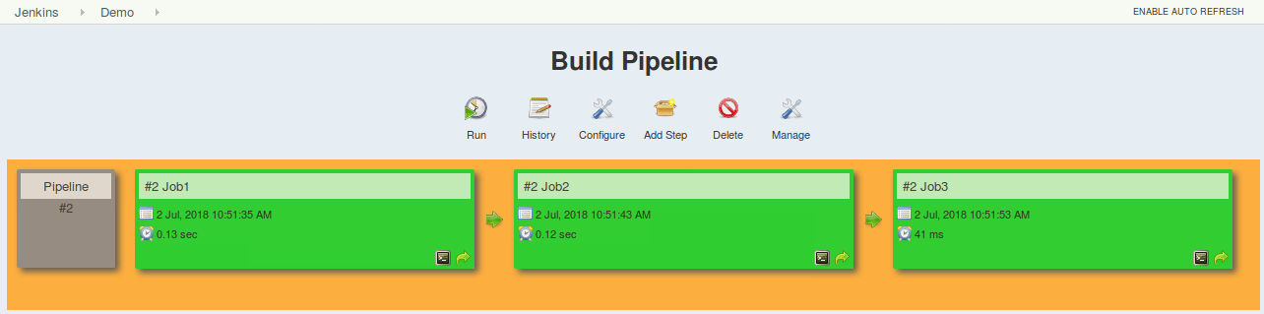
JENKINS PIPELINES
Pipelines leverage the power of multiple steps to execute both simple and complex tasks according to parameters that you establish.
Once created, pipelines can build code and orchestrate the work required to drive applications from commit to delivery.
Notes:
This was most commonly done via defining a series of individual jobs for the various pipeline tasks. Each job was configured via web forms—filling in text boxes, selecting entries from drop-down lists, etc. And then the series of jobs were strung together, each triggering the next, into a pipeline.
It did not meet the definition of infrastructure-as-code. Job configurations were stored only as XML files within the Jenkins configuration area. This meant that the files were not easily readable or directly modifiable
This approach is effective for deploying small applications. But what happens when there are complex pipelines with several processes (build, test, unit test, integration test, pre-deploy, deploy, monitor) running 100’s of jobs?
The key feature of this pipeline is to define the entire deployment flow through code

Slide 4
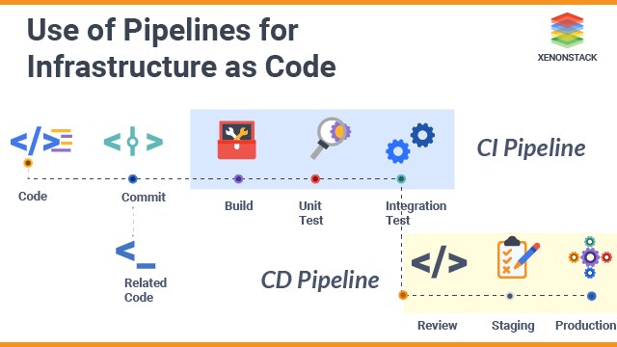

What is INFRASTRUCTURE AS CODE / PIPELINE AS CODE?
Notes:
Infrastructure-as-Code (Infrastructure as Code) is a DevOps rooted process for Operations and Infrastructure teams to extend infrastructure sections of computing, network, and storage using a method like Agile, Version Control, and Continuous Delivery Pipelines.
IaC refers to the practice of scripting the provisioning of hardware and operating system requirements concurrently with the development of the application itself. Typically, these scripts are managed in a similar manner to the software code base, including version control and automated testing.

Slide 5
INFRASTRUCTURE AS CODE / PIPELINE AS CODE
Make code your single source of truth
Version control all of your configuration files
Use little documentation (or none at all) for your infrastructure specifications
Test and Monitor Your Configurations
Notes:
You should explicitly code all the infrastructure specifications in configuration files. Your configuration files should be the single source of truth for all your infrastructure management concerns.
This probably should go without saying, but put all of your config files under source control.
This point is the logical consequence of the first one. Since your config files should be your single source of truth, there should be no need for more documentation. External documentation can easily get out of sync with the real configurations, but that won’t happen with the config files.
IaC is code, and like all code, it can be tested. So test it you should! By employing testing and monitoring tools for IaC, you can check for errors and inconsistencies in your servers before you deploy them to production.

Slide 6
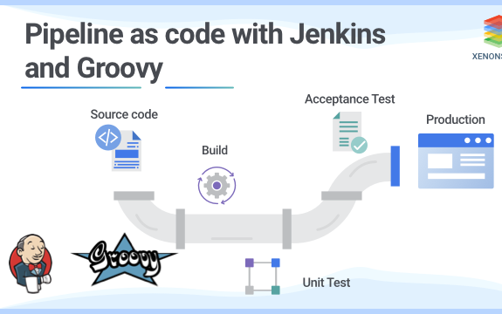
PIPELINES AS CODE
It means that all the standard jobs defined by Jenkins are manually written as one whole script and they can be stored in a version control system
It basically follows the ‘pipeline as code’ discipline. Instead of building several jobs for each phase, you can now code the entire workflow and put it in a Jenkinsfile
Notes:
DSL DOMAIN SPECIFIC LANGUAGE
https://www.edureka.co/blog/jenkins-pipeline-tutorial-continuous-delivery

Slide 7
ADVANTAGES OF PIPELINE AS CODE
Improves user interface by incorporating user input within the pipeline
It is durable in terms of unplanned restart of the Jenkins master
It can restart from saved checkpoints
It supports complex pipelines by incorporating conditional loops, fork or join operations and allowing tasks to be performed in parallel
It can integrate with several other plugins
The code is stored in a text file called the Jenkinsfile which can be checked into a SCM (Source Code Management)
It models simple to complex pipelines as code by using Groovy DSL (Domain Specific Language)

Slide 8
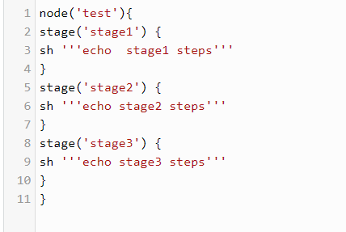
WHAT IS A JENKINSFILE?
A Jenkinsfile is a text file that stores the entire workflow as code and it can be checked into a SCM on your local system
This enables the developers to access, edit and check the code at all times
The Jenkinsfile is written using the Groovy DSL and it can be created through a text/groovy editor or through the configuration page on the Jenkins instance.

Slide 9
INTRODUCTION TO GROOVY
Groovy is an object-oriented programming language used for JVM platform. This dynamic language has a lot of features drawing inspiration from Python, Smalltalk & Ruby.
It can be used to orchestrate your pipeline in Jenkins and it can glue different languages together meaning that teams in your project can be contributing in different languages
Groovy can seamlessly interface with the Java language and the syntax of Java and Groovy is very similar

Slide 10
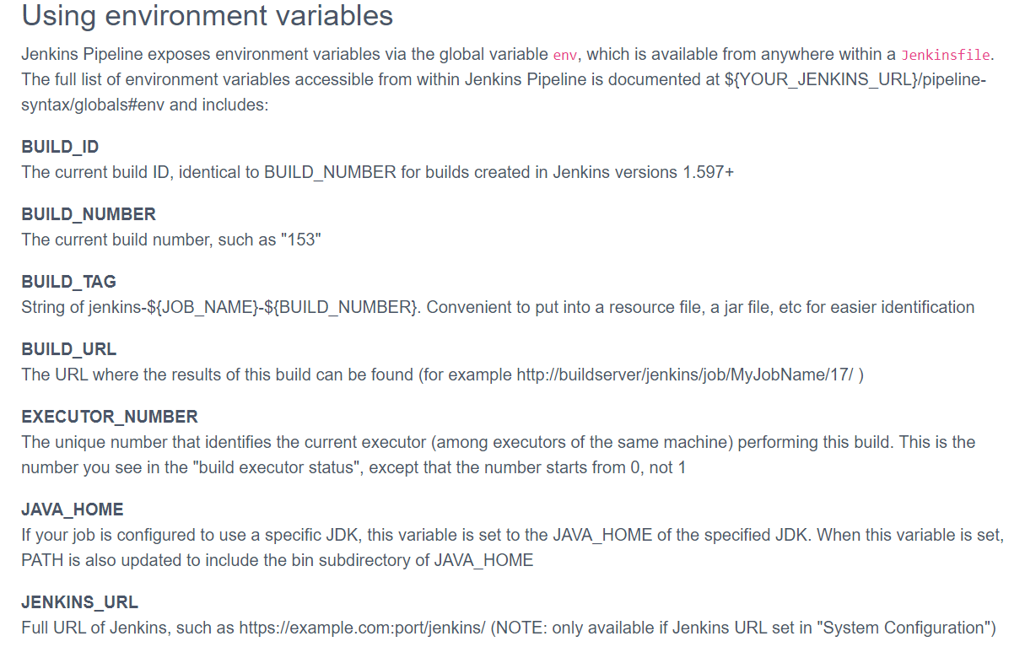
JENKINSFILE GROOVY BASICS
Variables in a Jenkinsfile can be defined by using the def keyword
Jenkins Environment Variable is a global variable exposed through the env variable and used anywhere in the Jenkinsfile

Slide 11

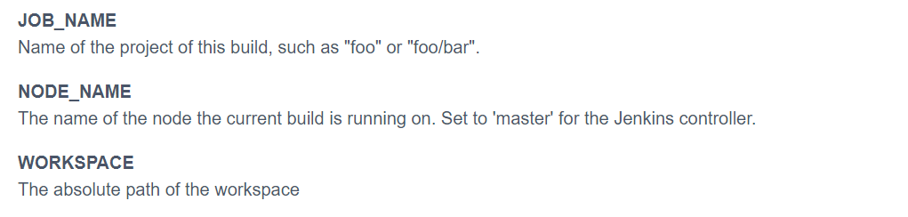
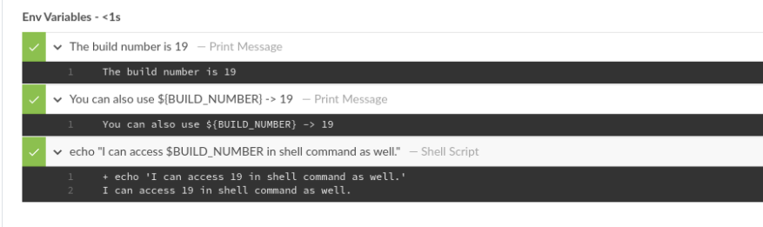
JENKINS ENVIRONMENT VARIABLES
Notes:
https://www.jenkins.io/doc/book/pipeline/jenkinsfile/#using-environment-variables
https://e.printstacktrace.blog/jenkins-pipeline-environment-variables-the-definitive-guide/
Define which node it runs on
Trigger another job using pipeline – build command Lab 2 part2
Pull requests ---- use git for first time run the job manually once

Slide 12
WHY USE GROOVY?
Groovy is an agile and dynamic language. It has seamless integration with all existing Java objects and libraries
In Groovy, the ‘for’ loop becomes more concise and easier to read. Groovy loop statements support: while, for, for-in, break, continue, and the whole is consistent with Java
In Groovy, we can use scopes to define Collections or Arrays
Groovy arithmetic operators, logical operators, relational operators and bitwise operators are all consistent with languages like nodeJS
List methods available in Groovy are another benefit
Groovy implicitly creates getters, setter methods, and provides constructors with arguments
Exception Handling is the same as Java, using try, catch to catch exceptions in Groovy
Notes:
-----put it in notes

Slide 13
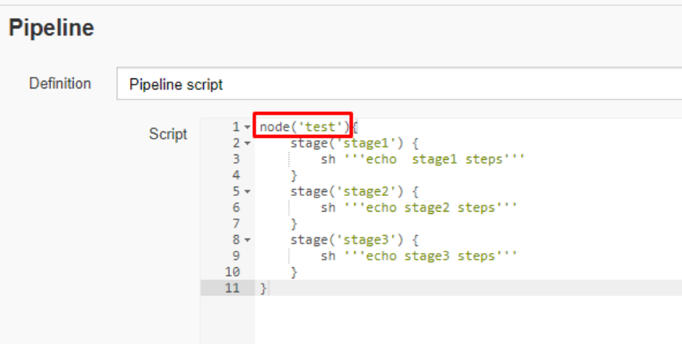
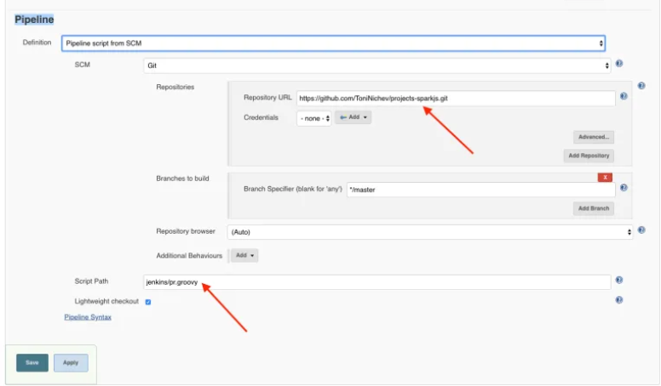
DEFINING A JENKINS PIPELINE
Jenkins Pipeline can be created in the following ways:
Through the classic UI -
You can directly enter the basic Pipeline into Jenkins using the classic UI
In SCM -
Jenkinsfile can be written manually and submitted to the project's source control repository.
Notes:
https://opensource.com/article/18/8/devops-jenkins-2

Slide 14
DEFINING A JENKINS PIPELINE
Instead of relying on creating freestyle jobs and configuring it, Jenkins pipeline has a set of instructions for the Jenkins job to execute.
Jenkinsfile created by the classic UI is saved directly by Jenkins.
Pipeline created from the Jenkins classic UI is saved in the root directory of Jenkins and script is executed in Jenkins script console.
The Jenkins file is a base code for Jenkins which executes it as a Groovy script in Jenkins script console.
Notes:
Clear picture ----------- teach about pipeline syntax generator

Slide 15
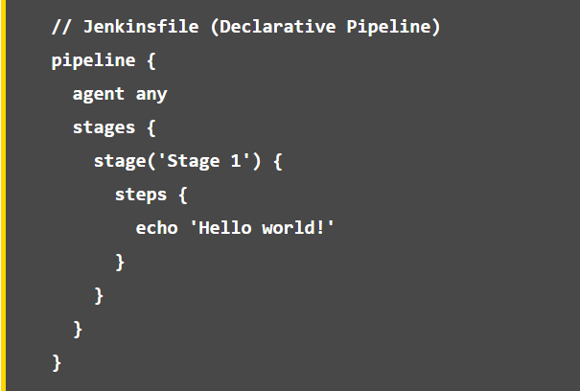
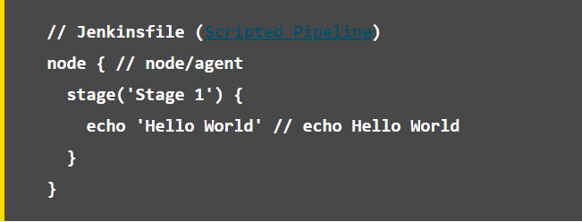
TYPES OF JENKINSFILE
DECLARATIVE PIPELINE SYNTAX
SCRIPTED PIPELINE SYNTAX
Scripted Pipeline
Notes:
Remove the shebang

Slide 16
DECLARATIVE Vs SCRIPTED JENKINSFILE SYNTAX
The scripted pipeline is a traditional way of writing the Jenkins pipeline as code
Unlike Declarative pipeline, the scripted pipeline strictly uses groovy based syntax. Because of this, the scripted pipeline provides huge control over the script and can manipulate the flow of script extensively. This helps developers to develop advance and complex pipeline as code
Notes:
Why to use scripted over declarative --- more inline with other languages

Slide 17

SCRIPTED JENKINSFILE CONCEPTS
NODE
STAGE
A node is a machine that executes an entire workflow
Stage block can be a single stage or multiple as the task goes. That is, the build, test, and deploy processes all come together in a stage. Generally, a stage block is used to visualize the Jenkins pipeline process.
Notes:
Scripted Pipelines are wrapped in a node block. Here a node refers to a system that contains the Jenkins agent pieces and can run jobs (formerly referred to as a slave instance)
The node block is a construct from the Groovy programming language called a closure (denoted by the opening and closing braces). In fact, Scripted Pipelines can include and make use of any valid Groovy code.

Slide 18
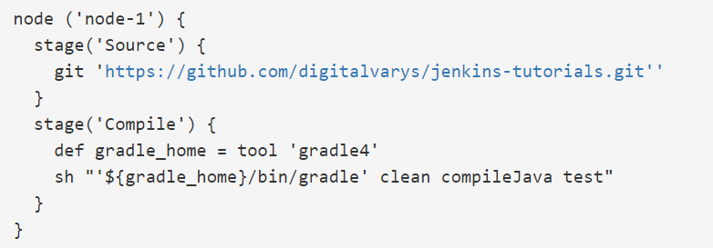
SCRIPTED JENKINSFILE CONCEPTS
Cloning the code from SCM
STAGE
Building the project
Deploying the code
Running the Unit Test cases
Other functional and performance tests
Notes:
Re-arrange based on scripted pipeline

Slide 19
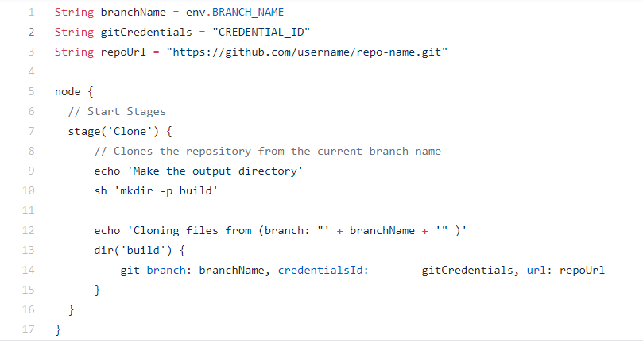
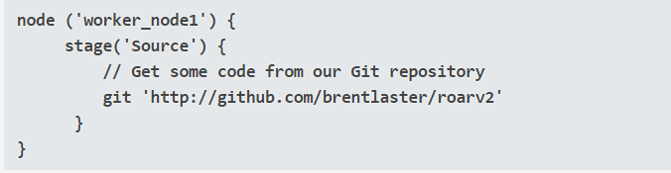
USING A JENKINSFILE WITH EXAMPLES
The sh step is used to execute a shell command in a Pipeline
Get code from a git repository in jenkinsfile
Notes:
NOTE- We have specified which Node should this run on here in this case it is Test Node
we have a git step provided via the Git plugin to retrieve source code from the source control system.

Slide 20
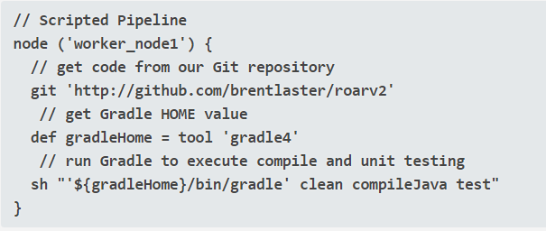
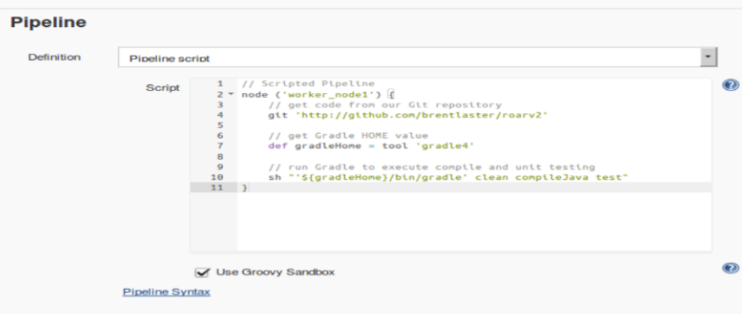
USING A JENKINSFILE WITH EXAMPLES
Notes:
Scripted Pipeline code that does several things:
retrieves source code (via the git pipeline step);
gets the value of a globally defined Gradle installation (via the tool pipeline step) and puts it into a Groovy variable; and
calls the shell to execute it (via the sh pipeline step)
Here gradleHome is a Groovy variable used to support the DSL steps

Slide 21
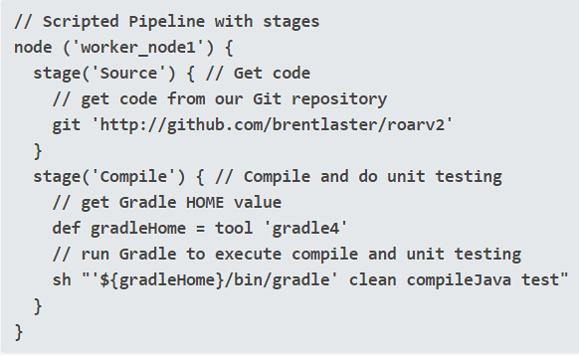
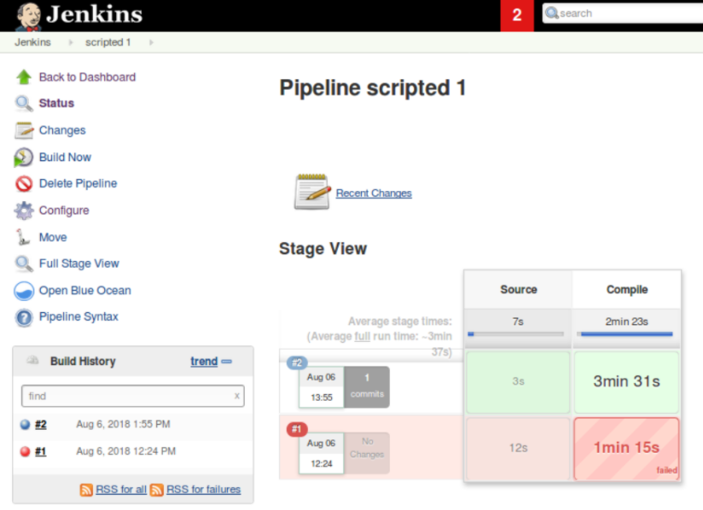
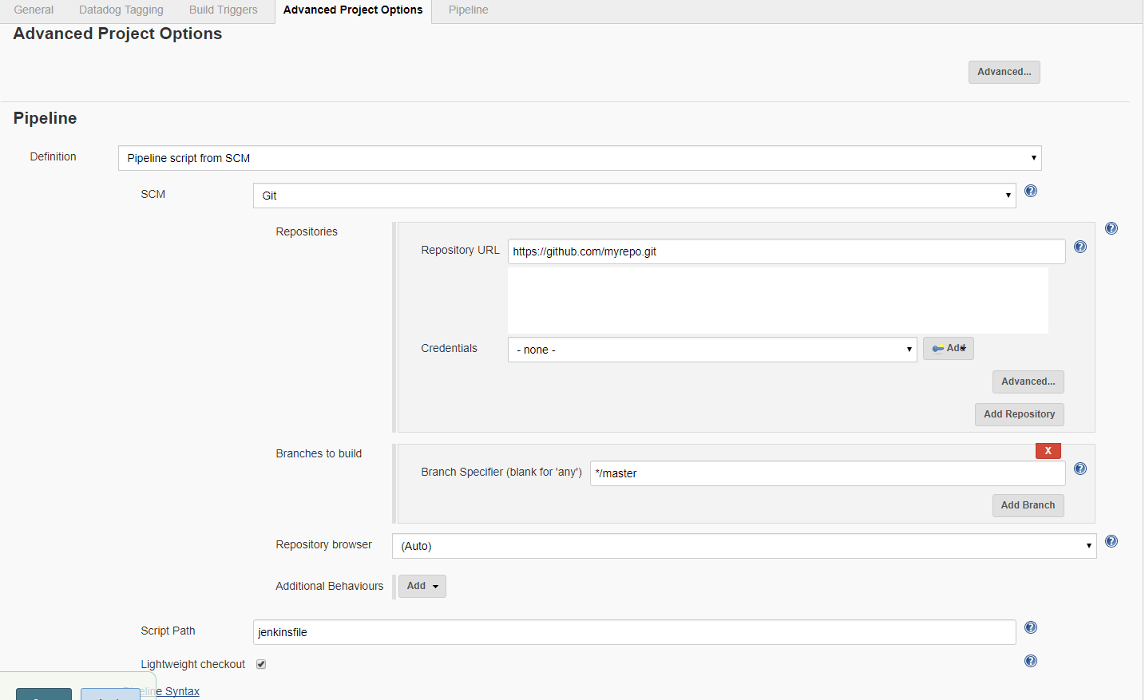

USING A JENKINSFILE WITH EXAMPLES
Notes:
Jenkins pipelines generally have a further level of granularity—stages. A stage is a way to divide up the pipeline into logical functional units. It also serves to group DSL steps and Groovy code together to do targeted functionality.
Each stage in a pipeline also gets its own output area in the new default Jenkins output screen—the Stage
the Stage View output is organized as a matrix, with each row representing a run of the job, and each column mapped to a defined stage in the pipeline:View.
Each cell in this matrix (intersection of a row and column) also shows timing information and uses colors as an indication of success or failure

Slide 22
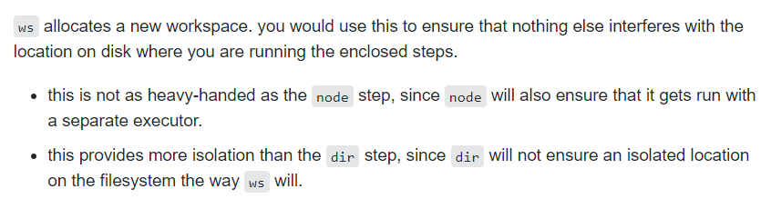
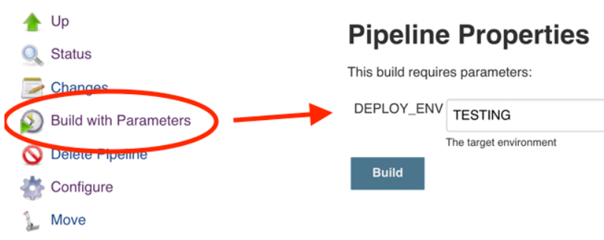
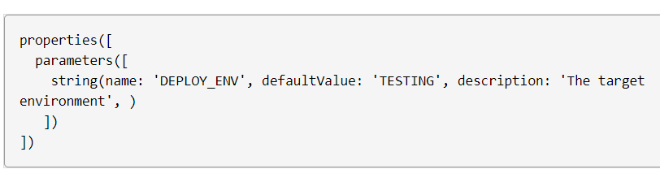
USING A JENKINSFILE WITH EXAMPLES
Notes:
Allocates a workspace. Note that a workspace is automatically allocated for you with the node step.
https://www.jenkins.io/doc/pipeline/steps/pipeline-input-step/

Slide 23
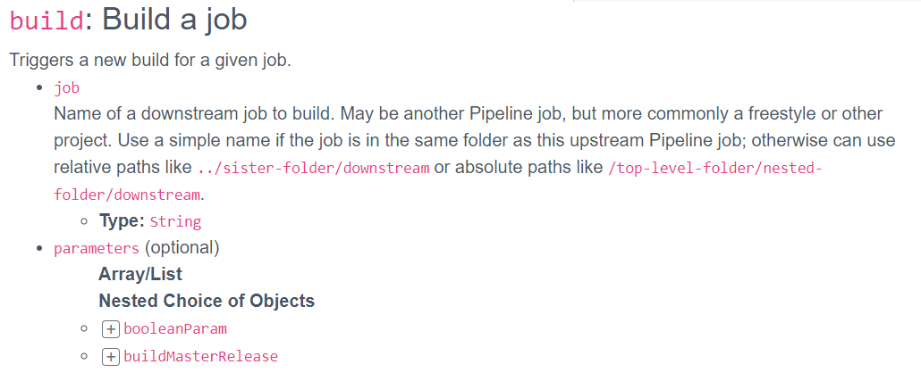
USING A JENKINSFILE WITH EXAMPLES
Notes:
Allocates a workspace. Note that a workspace is automatically allocated for you with the node step.
https://www.jenkins.io/doc/pipeline/steps/pipeline-input-step/

Slide 24
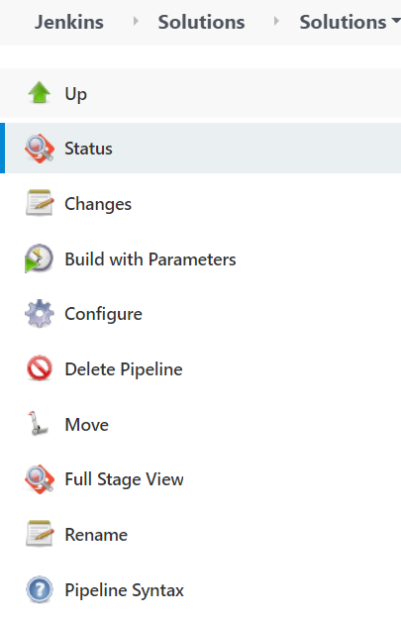
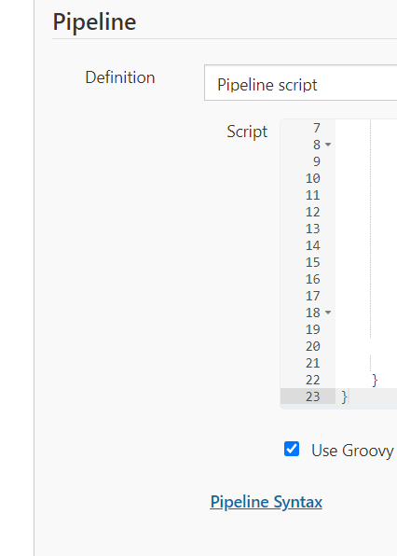
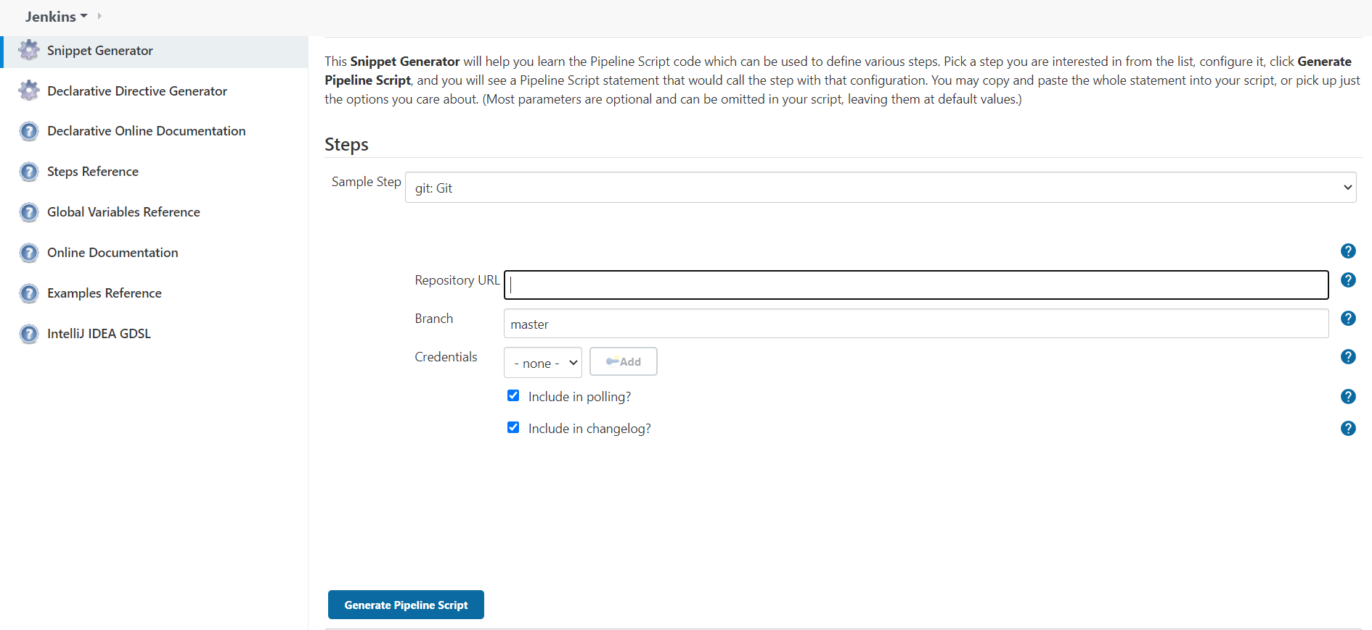
JENKINS PIPELINE SNIPPET GENERATOR
Notes:
Link of our instance - https://sigmaci-course01-master.northeurope.cloudapp.azure.com/view/Solutions/job/Solutions/job/Lab2_2%20Solution/pipeline-syntax/

Slide 25

JENKINS demo
Notes:
Jenkins demo

